Slide 1
Distracted-Driver-Detection
Project progress review presentation
Siva Krishna THOTA

Slide 2
Recap : Project objectives
This project focuses on driver distraction
Activities detection via images using
different kinds of machine learning and
Deep learning techniques
Linear SVM, KNN, ADA Boost ,Bagging,
Decision Tree, CNN, ResNet , VGG
Project goal is to build a high-accuracy
model to distinguish whether drivers is
driving safely or conducting a particular
kind of distraction activity
Classification and detection
problem statement

Slide 3
Recap : Dataset
The dataset contains 22424 driver images in total downloaded from kaggle.
The dataset contains colored images of size 640 x 480 pixels.
Stratified splitting will use to split the dataset into 80:10 Training-Testing ratio.
The training dataset is further split into 90:10 Training-Validation set.
10 classes to predict

Slide 4
Distraction Activities
0: Safe driving
1: Texting - right
2: Talking on the phone - right
3: Texting - left
4: Talking on the phone - left
5: Operating the radio
6: Drinking
7: Reaching behind
8: Hair and makeup
9: Talking to passenger

Slide 5
Recap : Technical Approach
Feature Extraction (RGB,HOG,LBP,SUF,KAZE,Color historgram , GrayScale
Preprocessing (Mini- Max Normalization )
Dimensionality Reduction (PCA,LDA)
Classification(Decisi Tree,SVM,KNN,XGBoost,Bagging,ADABoost,CNN,VGG,RestNet-101
Class Prediction
Evaluation Metrics (Classification Report - Precision , Recall, etc )

Slide 6
Experimental Results Machine Learning Algorithms SVM
PCA
LDA
PCA -LDA
Best Parameters: {'C': 100, 'kernel': 'rbf'}
Best Accuracy: 99.76 %
Best Accuracy Testing Data: 18 %
Best Parameters: {'C': 0.1, 'kernel': 'rbf'}
Best Accuracy: 96.87 %
Best Accuracy Testing Data: 77 %
Best Parameters: {'C': 1, 'kernel': 'rbf'}
Best Accuracy: 98.43 %
Best Accuracy Testing Data: 19 %
KNN
PCA
LDA
PCA -LDA
Best Parameters: {'n_neighbors': 5}
Best Parameters:{'n_neighbors':51}
Best Parameters:{'n_neighbors': 5}
Best Accuracy: 98.89 %
Best Accuracy Testing Data: 18 %
Best Accuracy: 96.68 %
Best Accuracy Testing Data: 77 %
Best Accuracy: 98.45 %
Best Accuracy Testing Data: 20%

Slide 7
Experimental Results Machine Learning Algorithms Bagging
PCA
LDA
PCA -LDA
Best Parameters: {'n_estimators': 40}
Best Parameters: {'n_estimators': 40}
Best Parameters: {'n_estimators': 20}
Best Accuracy: 95.91 %
Best Accuracy Testing Data: 23%
Best Accuracy: 91.23 %
Best Accuracy Testing Data: 63 %
Best Accuracy: 97.46 %
Best Accuracy Testing Data: 19 %
Decision Tree
PCA
LDA
PCA -LDA
Best Parameters: {'criterion': 'entropy', 'max_depth': 20}
Best Parameters: {'criterion': 'entropy', 'max_depth': 15}
Best Parameters: {'criterion': 'entropy', 'max_depth': 15}
Best Accuracy Training Data: 85.95 %
Best Accuracy Testing Data : 19.0%
Best Accuracy Training Data: 80.69 %
Best Accuracy Testing Data : 52.0%
Best Accuracy Training Data: 96.04 %
Best Accuracy Testing Data : 17.0%

Slide 8
LDA Result
SVM 77%
KNN
77%
Bagging 63%
Decision Tree 52%

Slide 9
Machine Learning Models Conclusion Machine Learning Algorithms are not fit for this Problem Statement Because Accuracy is very low , High accuracy is 77% only
SVM and KNN Performing Well
PCA , LDA – PCA Not Performing Well
Bagging ,Decision Tree Not Performing Well
LDA features Performing Well

Slide 10
Experimental Results Deep Learning Algorithms
Res Net101
Val Accuracy : 65%
Test Accuracy : 63%
Strategy #1 Freezing All Layers Parameters

Slide 11
Experimental Results Deep Learning Algorithms
Strategy #2 Freezing Previous Layers and Training Only Last few
Res Net101
Val Accuracy : 98%
Test Accuracy : 98%

Slide 12
Experimental Results Deep Learning Algorithms
VGG
Val Accuracy : 99%
Test Accuracy : 99%

Slide 13
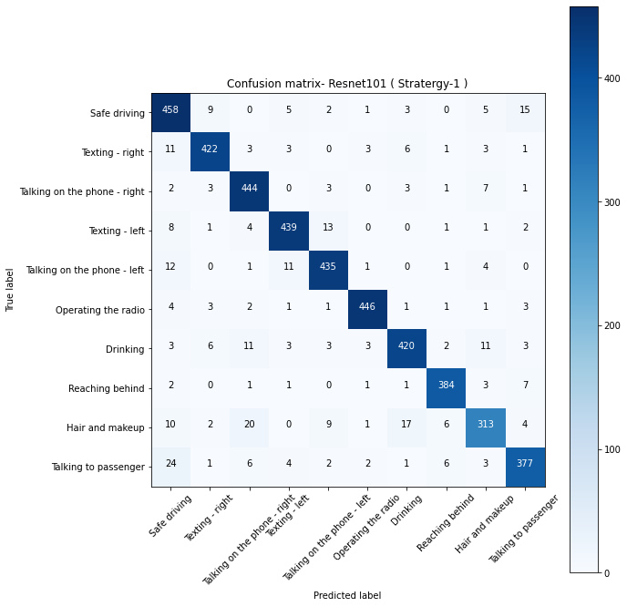
Res Net 101 – Strategy #1

Slide 14
Res Net 101 Strategy #1 Classification Report
 | Precision | Recall | F1-score | Support
Safe Driving | 0.857678 | 0.919679 | 0.887597 | 498
Texting - Right | 0.944072 | 0.931567 | 0.937778 | 453
Talking on the Phone - Right | 0.902439 | 0.956897 | 0.92887 | 464
Texting - Left | 0.940043 | 0.936034 | 0.938034 | 469
Talking on the Phone - Left | 0.929487 | 0.935484 | 0.932476 | 465
Operating the Radio | 0.973799 | 0.963283 | 0.968512 | 463
Drinking | 0.929204 | 0.903226 | 0.916031 | 465
Reaching Behind | 0.952854 | 0.96 | 0.956413 | 400
Hair and Makeup | 0.891738 | 0.819372 | 0.854025 | 382
Talking to Passenger | 0.912833 | 0.884977 | 0.898689 | 426
Accuracy | 0.922631 | 0.922631 | 0.922631 | 0.922631
Macro avg | 0.923415 | 0.921052 | 0.921842 | 4485
Weighted avg | 0.923124 | 0.922631 | 0.922495 | 4485

Slide 15
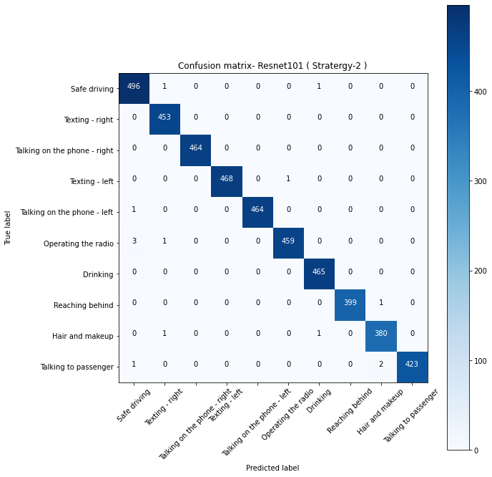
Res Net 101 – Strategy #2

Slide 16
Res Net 101 – Strategy #2 Classification Report
 | Precision | Recall | F1-score | Support
Safe driving | 0.99001996 | 0.995983936 | 0.992992993 | 498
Texting - right | 0.993421053 | 1 | 0.99669967 | 453
Talking on the phone - right | 1 | 1 | 1 | 464
Texting - left | 1 | 0.997867804 | 0.998932764 | 469
Talking on the phone - left | 1 | 0.997849462 | 0.998923574 | 465
Operating the radio | 0.997826087 | 0.991360691 | 0.994582882 | 463
Drinking | 0.995717345 | 1 | 0.997854077 | 465
Reaching behind | 1 | 0.9975 | 0.998748436 | 400
Hair and makeup | 0.992167102 | 0.994764398 | 0.993464052 | 382
Talking to passenger | 1 | 0.992957746 | 0.996466431 | 426
Accuracy | 0.996878484 | 0.996878484 | 0.996878484 | 0.996878484
Macro avg | 0.996915155 | 0.996828404 | 0.996866488 | 4485
Weighted avg | 0.996891762 | 0.996878484 | 0.996879766 | 4485

Slide 17
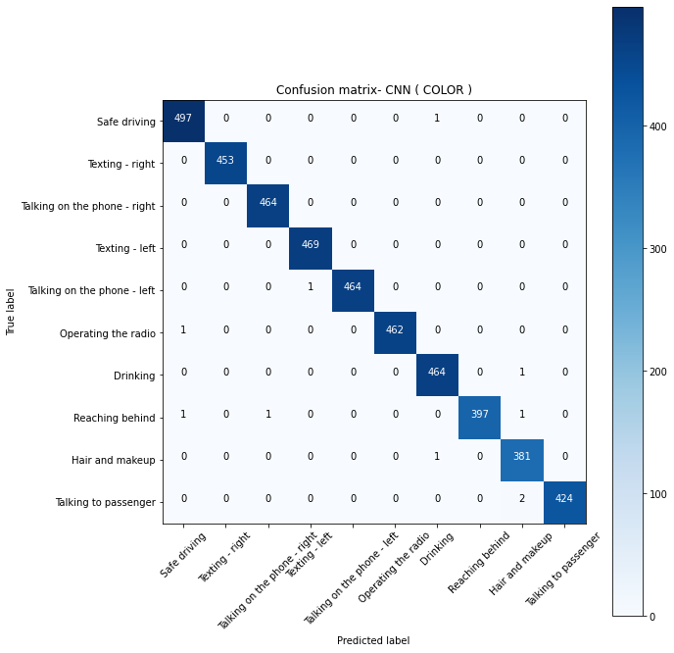
VGG

Slide 18
VGG Classification Report
 | Precision | Recall | F1-score | Support
Safe driving | 0.995991984 | 0.997991968 | 0.996990973 | 498
Texting - right | 1 | 1 | 1 | 453
Talking on the phone - right | 0.997849462 | 1 | 0.998923574 | 464
Texting - left | 0.99787234 | 1 | 0.998935037 | 469
Talking on the phone - left | 1 | 0.997849462 | 0.998923574 | 465
Operating the radio | 1 | 0.997840173 | 0.998918919 | 463
Drinking | 0.995708155 | 0.997849462 | 0.996777658 | 465
Reaching behind | 1 | 0.9925 | 0.996235885 | 400
Hair and makeup | 0.98961039 | 0.997382199 | 0.993481095 | 382
Talking to passenger | 1 | 0.995305164 | 0.997647059 | 426
Accuracy | 0.997770346 | 0.997770346 | 0.997770346 | 0.997770346
Macro avg | 0.997703233 | 0.997671843 | 0.997683377 | 4485
Weighted avg | 0.9977801 | 0.997770346 | 0.997771435 | 4485

Slide 19
Deep Learning Models Conclusion Compare to Res Net Model VGG Accuracy is high, but in Real time Videos Rest Net Performing Well
Rest Net Strategy #1 Not performing well
Rest Net Strategy #2 Performing Well – 98%
VGG Performing Well -99%

Slide 20
Current Features
Recognize Activity for each Frame
Identify objects like Mobile , Tea Cup , etc.. Using Pre trained models
Detect Faces and eyes
Web Application to test our models using real time videos , Images

Slide 21
1. Collected Real Time videos from internet and tested model 2. Developed web pages for testing our models using python , Dash
Done so far
Extracted Features using Sift , LBP, Color Histogram, KAZE
Experiments performed in machine Learning algorithms SVM , KNN , Bagging , Decision Tree
Trained Deep Learning algorithms Res Net , VGG , CNN

Slide 22
Next steps
Data augmentation like flip images with some angles and extract features
After Extracting features Train Deep Learning models Res Net and VGG models because in real time videos (Downloaded from internet ) and images existing algorithms not performing well due to camera angles
Collect Real Time Videos and images and Test Using Trained models

Slide 23
Feature development
What should you do if your driver falls asleep?
If you are in a car with a driver who is clearly too sleepy to drive, suggest that they pull over and take a nap,
offer to take over the driving duties if you are not tired and able to drive.

Slide 24
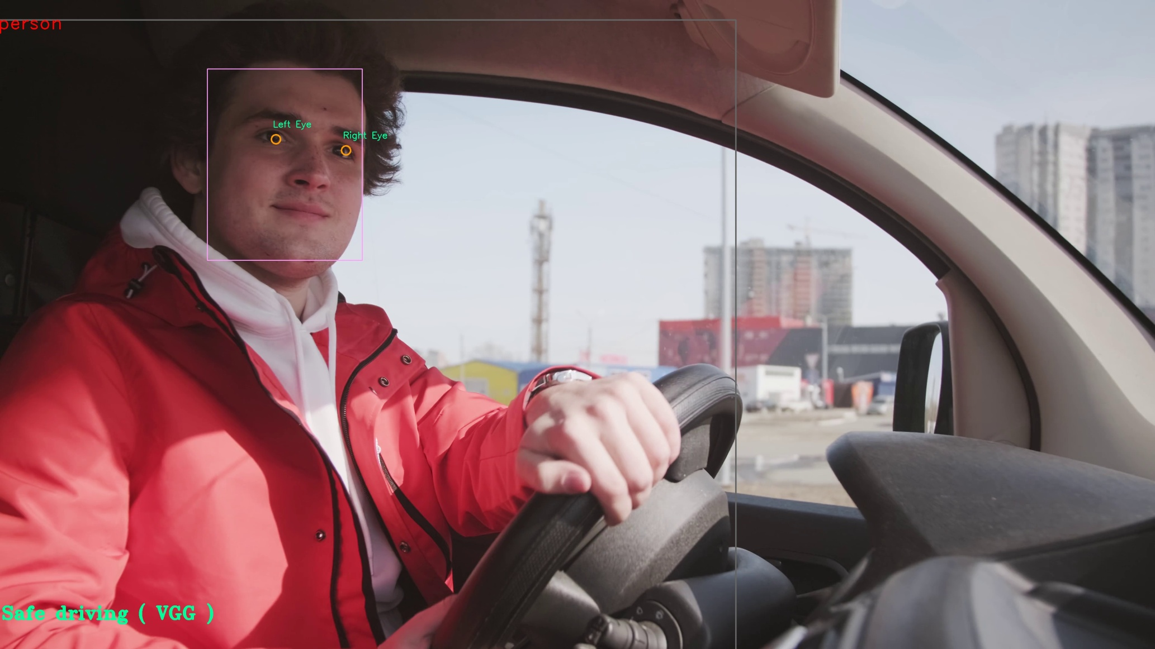
Model Outputs

Slide 25
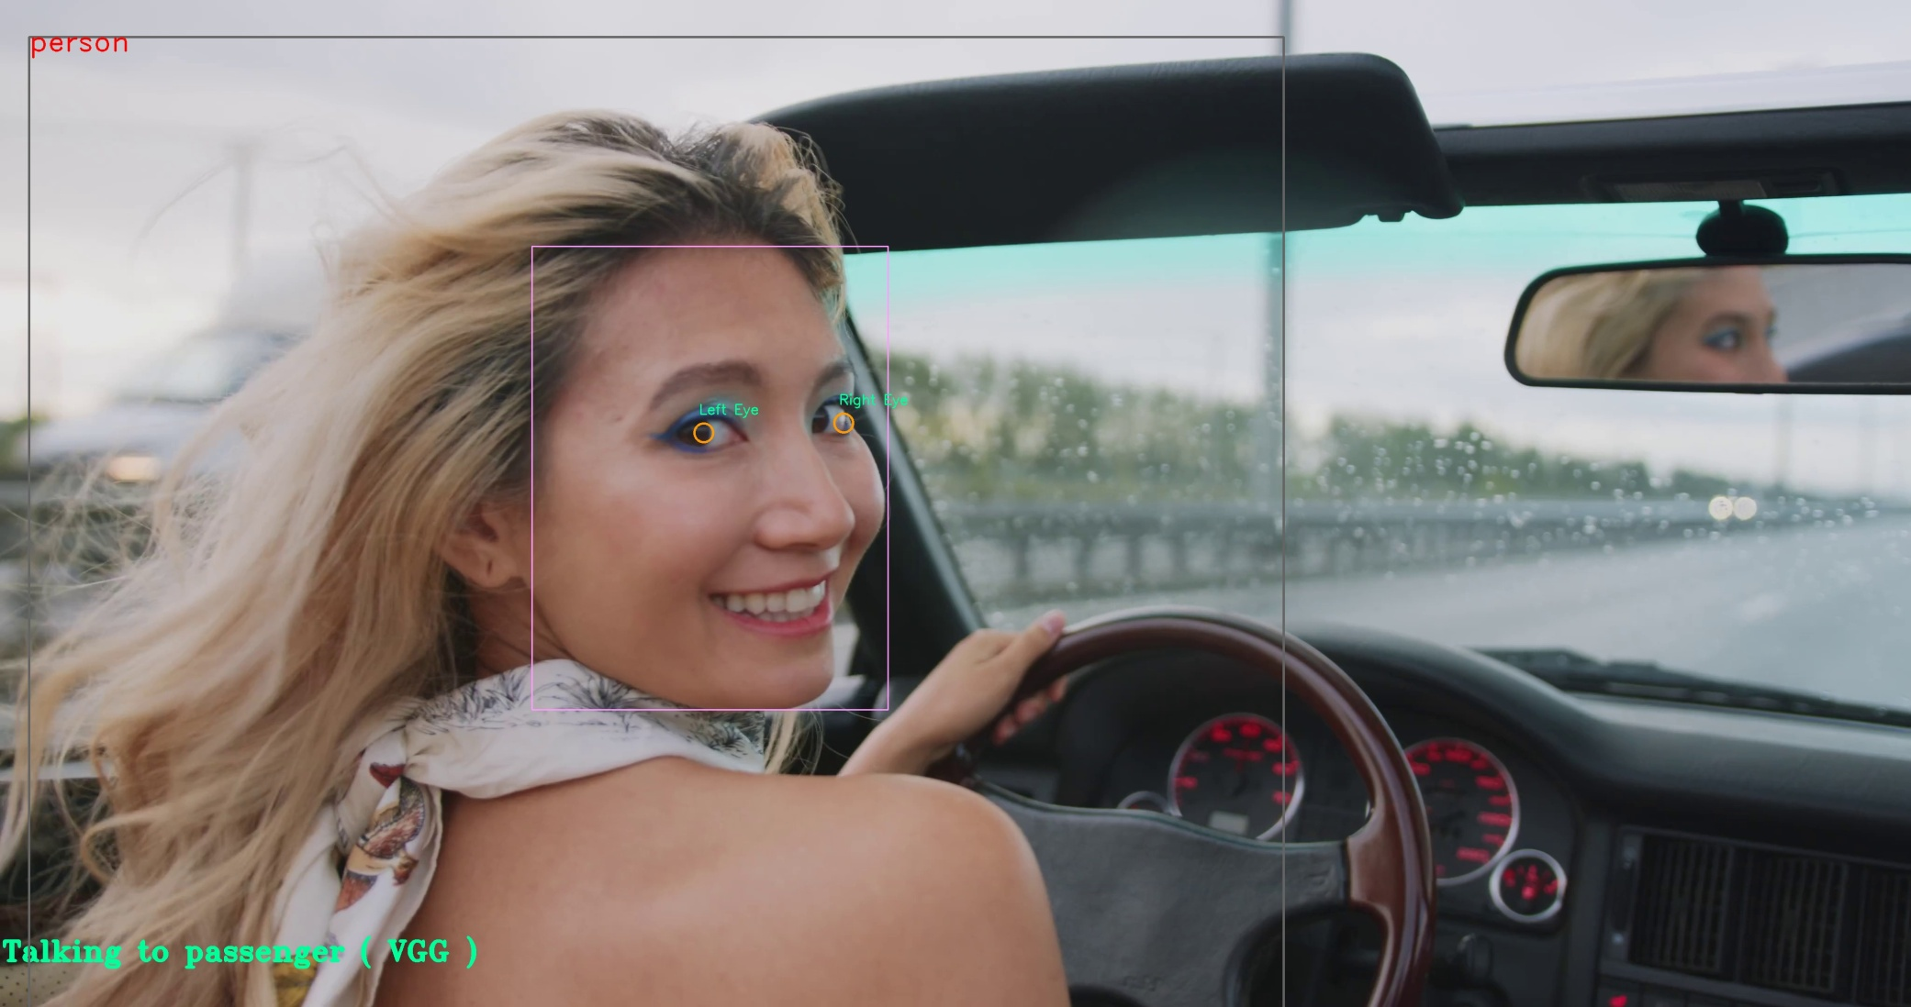

Slide 26
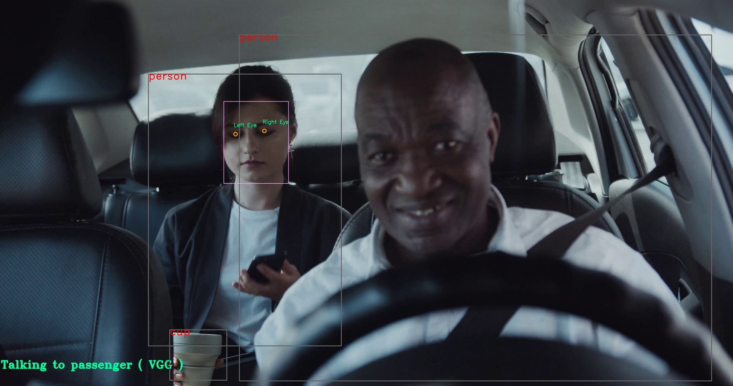

Slide 27
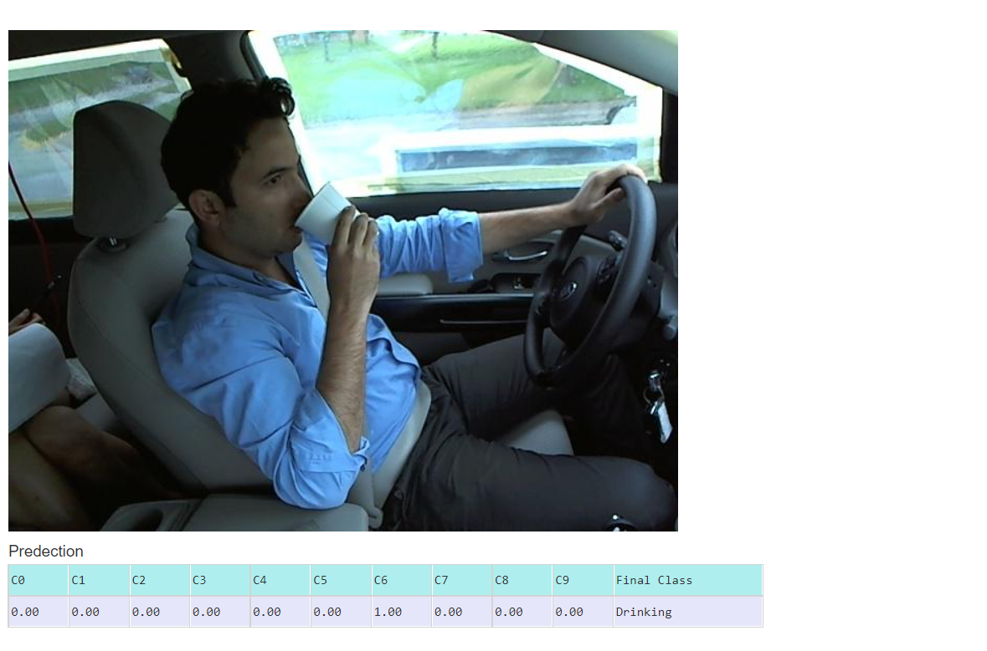
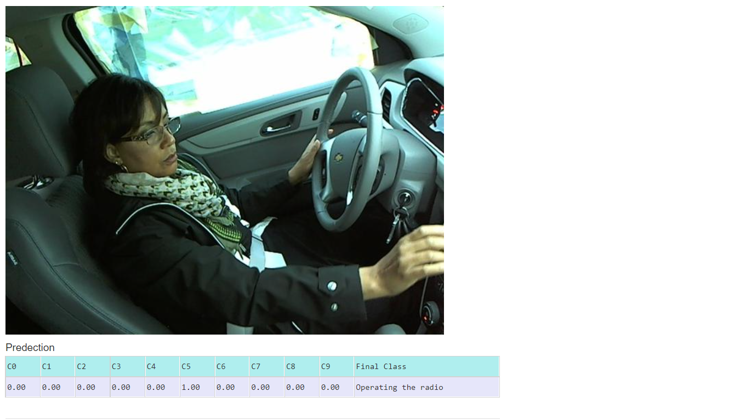

Slide 28
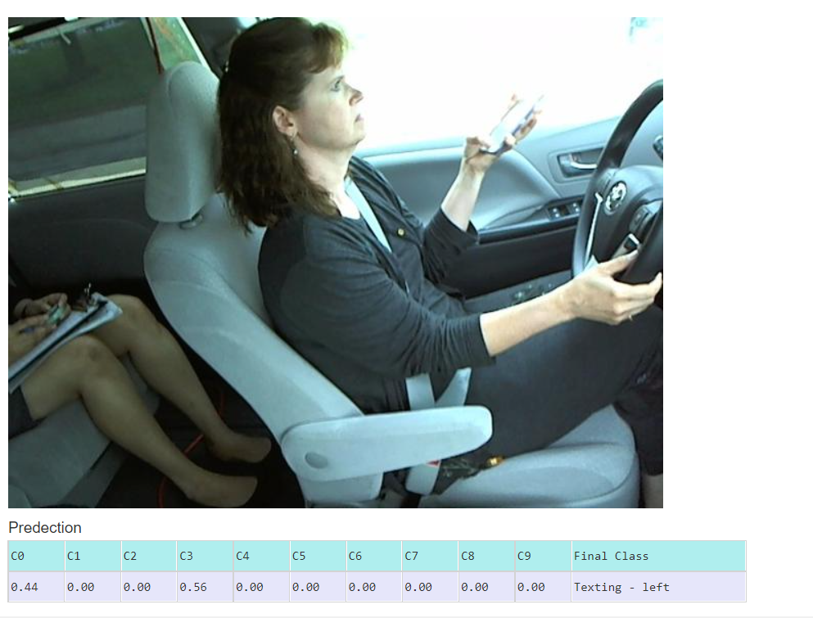
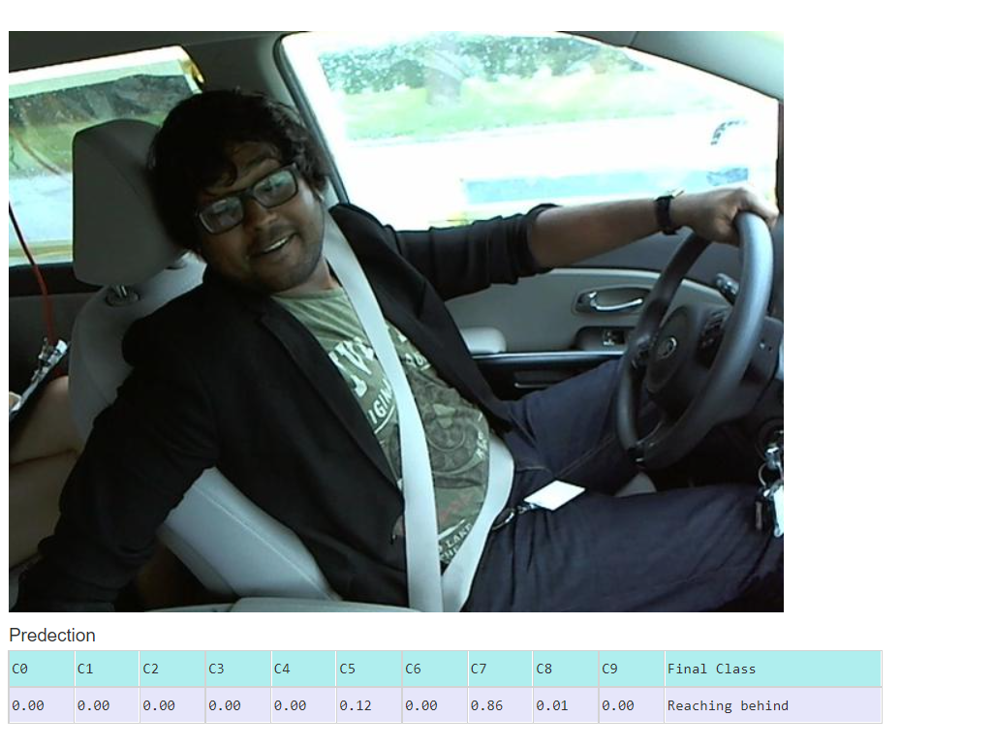

Slide 29
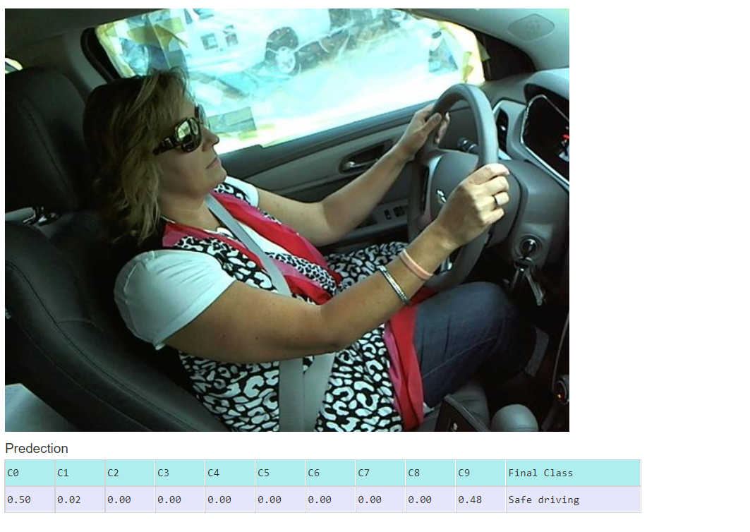

Slide 30
References
List the relevant references.
https://snappishproductions.com/blog/2018/01/03/class-activation-mapping-in-pytorch.html.html
https://medium.com/@sam.bell_43711/distracted-driver-detection-using-deep-learning-ecc7216ae8d0
https://github.com/Garima13a/YOLO-Object-Detection/blob/master/YOLO.ipynb
https://colab.research.google.com/github/d2l-ai/d2l-en-colab/blob/master/chapter_deep-learning-computation/use-gpu.ipynb#scrollTo=mwrEJrSCo-OR
https://github.com/opencv/opencv

